Slide 1
Big Streaming Data
EMPOWERING High Performance Technology Teams

Slide 2


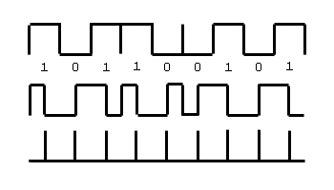
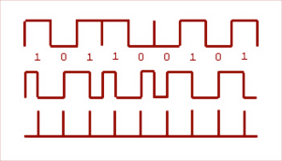



Big Streaming Data Processing
Fraud detection in bank transactions
Anomalies in sensor data
Cat videos in tweets

Slide 3



How to Process Big Streaming Data
Distributed Processing System
Raw Data Streams
Processed Data
Scales to hundreds of nodes
Achieves low latency Efficiently recover from failures
Integrates with batch and interactive processing

Slide 4

What people have been doing?
Build two stacks – one for batch, one for streaming
Often both process same data
Existing frameworks cannot do both
Either, stream processing of 100s of MB/s with low latency
Or, batch processing of TBs of data with high latency
Extremely painful to maintain two different stacks
Different programming models
Doubles implementation effort
Doubles operational effort

Slide 5






Fault-tolerant Stream Processing
Traditional processing model
– Pipeline of nodes
input
mutable state
Each node maintains mutable state
Each input record updates the state and new records are sent out
records
node 1
input
node 3
records
node 2
Mutable state is lost if node fails
Making stateful stream processing fault-tolerant is challenging!

Slide 6
Existing Streaming Systems
Storm
Replays record if not processed by a node
Processes each record at least once
May update mutable state twice!
Mutable state can be lost due to failure!
Trident – Use transactions to update state
Processes each record exactly once
Per-state transaction to external database is slow
9

Slide 7


treaming

Slide 8
What is Spark Streaming?
Receive data streams from input sources, process them in a cluster, push out to databases/ dashboards
Scalable, fault-tolerant, second-scale latencies
Kafka Flume HDFS
Kinesis Twitter
HDFS
Databases Dashboards
treaming

Slide 9


How does Spark Streaming work?
Chop up data streams into batches of few secs
Spark treats each batch of data as RDDs and processes them using RDD operations
Processed results are pushed out in batches
treaming
Receivers
data streams
batches as RDDs
results as RDDs

Slide 10
Spark Streaming Programming Model
Discretized Stream (DStream)
Represents a stream of data
Implemented as a sequence of RDDs
DStreams API very similar to RDD API
Functional APIs in Scala, Java
Create input DStreams from different sources
Apply parallel operations

Slide 11
















Example – Get hashtags from Twitter
val ssc = new StreamingContext(sparkContext, Seconds(1)) val tweets = TwitterUtils.createStream(ssc, auth)
Input DStream
Twitter Streaming API
batch @ t
batch @ t+1
batch @ t+2
tweets DStream
stored in memory as RDDs

Slide 12








Example – Get hashtags from Twitter
val tweets = TwitterUtils.createStream(ssc, None)
val hashTags = tweets.flatMap(status => getTags(status))
transformed DStream
transformation: modify data in one DStream to create another DStream
batch @ t
batch @ t+1
batch @ t+2
tweets DStream
ﬂatMap
ﬂatMap
ﬂatMap
hashTags Dstream
[#cat, #dog, … ]
…
new RDDs created for every batch

Slide 13








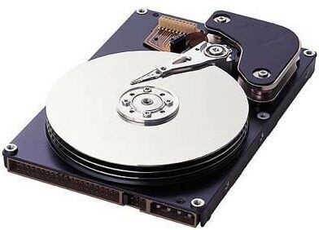
Example – Get hashtags from Twitter
val tweets = TwitterUtils.createStream(ssc, None)
val hashTags = tweets.flatMap(status => getTags(status)) hashTags.saveAsHadoopFiles("hdfs://...")
output operation: to push data to external storage
batch @ t
batch @ t+1
batch @ t+2
tweets DStream
flatMap
flatMap
flatMap
hashTags DStream
save
save
save
every batch saved to HDFS

Slide 14
Example – Get hashtags from Twitter
val tweets = TwitterUtils.createStream(ssc, None)
val hashTags = tweets.flatMap(status => getTags(status)) hashTags.foreachRDD(hashTagRDD => { ... })
foreach: do whatever you want with the processed data
batch @ t
batch @ t+1
batch @ t+2
tweets DStream
flatMap
flatMap
flatMap
hashTags DStream
foreach
foreach
foreach
Write to a database, update analytics UI, do whatever you want

Slide 15
Languages
Scala API
val tweets = TwitterUtils.createStream(ssc, auth)
val hashTags = tweets.flatMap(status => getTags(status))
hashTags.saveAsHadoopFiles("hdfs://...”)
Java API
JavaDStream<Status> tweets = ssc.twitterStream()
Function object
JavaDstream<String> hashTags = tweets.flatMap(new Function<...> { }) hashTags.saveAsHadoopFiles("hdfs://...")
Python API
...soon

Slide 16







Window-based Transformations
val tweets = TwitterUtils.createStream(ssc, auth)
val hashTags = tweets.flatMap(status => getTags(status))
val tagCounts = hashTags.window(Minutes(1), Seconds(5)).countByValue()
sliding window operation
window length
sliding interval
window length
DStream of data
sliding interval

Slide 17
Arbitrary Stateful Computations
Specify function to generate new state based on previous state and new data
- Example: Maintain per-user mood as state, and update it with their tweets
def updateMood(newTweets, lastMood) => newMood
val moods = tweetsByUser.updateStateByKey(updateMood _)

Slide 18
Arbitrary Combinations of Batch and Streaming Computations
Inter-mix RDD and DStream operations!
- Example: Join incoming tweets with a spam HDFS file to filter out bad tweets
tweets.transform(tweetsRDD => { tweetsRDD.join(spamFile).filter(...)
})

Slide 19













DStreams + RDDs = Power
Combine live data streams with historical data
Generate historical data models with Spark, etc.
Use data models to process live data stream
Combine streaming with MLlib, GraphX algos
Offline learning, online prediction
Online learning and prediction
Spark
SQL
Spark Streaming
MLlib
machine learning
GraphX
graph processing
Apache Spark
Interactively query streaming data using SQL
- select * from table_from_streaming_data

Slide 20






Advantage of an Unified Stack
Explore data interactively to identify problems
$ ./spark-­‐shell
scala> val file = sc.hadoopFile(“smallLogs”)
...
scala> val filtered = file.filter(_.contains(“ERROR”))
...
scala> val mapped = filtered.map(...)
. object ProcessProductionData { def main(args: Array[String]) {
..
Use same code in Spark for processing large logs
val sc = new SparkContext(...)
val file = sc.hadoopFile(“productionLogs”)
val filtered = file.filter(_.contains(“ERROR”))
val mapped = filtered.map(...)
...
}
} object ProcessLiveStream {
def main(args: Array[String]) {
val sc = new StreamingContext(...)
val stream = KafkaUtil.createStream(...)
Use similar code in Spark Streaming for realtime processing
val filtered = stream.filter(_.contains(“ERROR”)) val mapped = filtered.map(...)
...
}
}

Slide 21



Performance
Can process 60M records/sec (6 GB/sec) on 100 nodes at sub-second latency
7
6
5
4
3
2
1
0
3.5
3
2.5
2
1.5
1
0.5
0
Cluster Thhroughput (GB/s)
Grep
Cluster Throughput (GB/s)
WordCount
sec
sec
sec
sec
0
50
# Nodes in Cluster
100
0
50
# Nodes in Cluster
100

Slide 22






















Fault-tolerance
Batches of input data are replicated in memory for fault-tolerance
tweets RDD
input data replicated in memory
Data lost due to worker failure, can be recomputed from replicated input data
ﬂatMap
hashTags RDD
lost partitions recomputed on other workers
>All transformations are fault- tolerant, and exactly-once transformations

Slide 23
Input Sources
Out of the box, we provide
Kafka, Flume, Kinesis, Raw TCP sockets, HDFS, etc.
Very easy to write a custom receiver
Define what to when receiver is started and stopped
Also, generate your own sequence of RDDs, etc. and push them in as a “stream”

Slide 24
Output Sinks
HDFS, S3, etc (Hadoop API compatible filesystems)
Cassandra (using Spark-Cassandra connector)
Hbase (integrated support coming to Spark soon)
Directly push the data anywhere

Slide 25
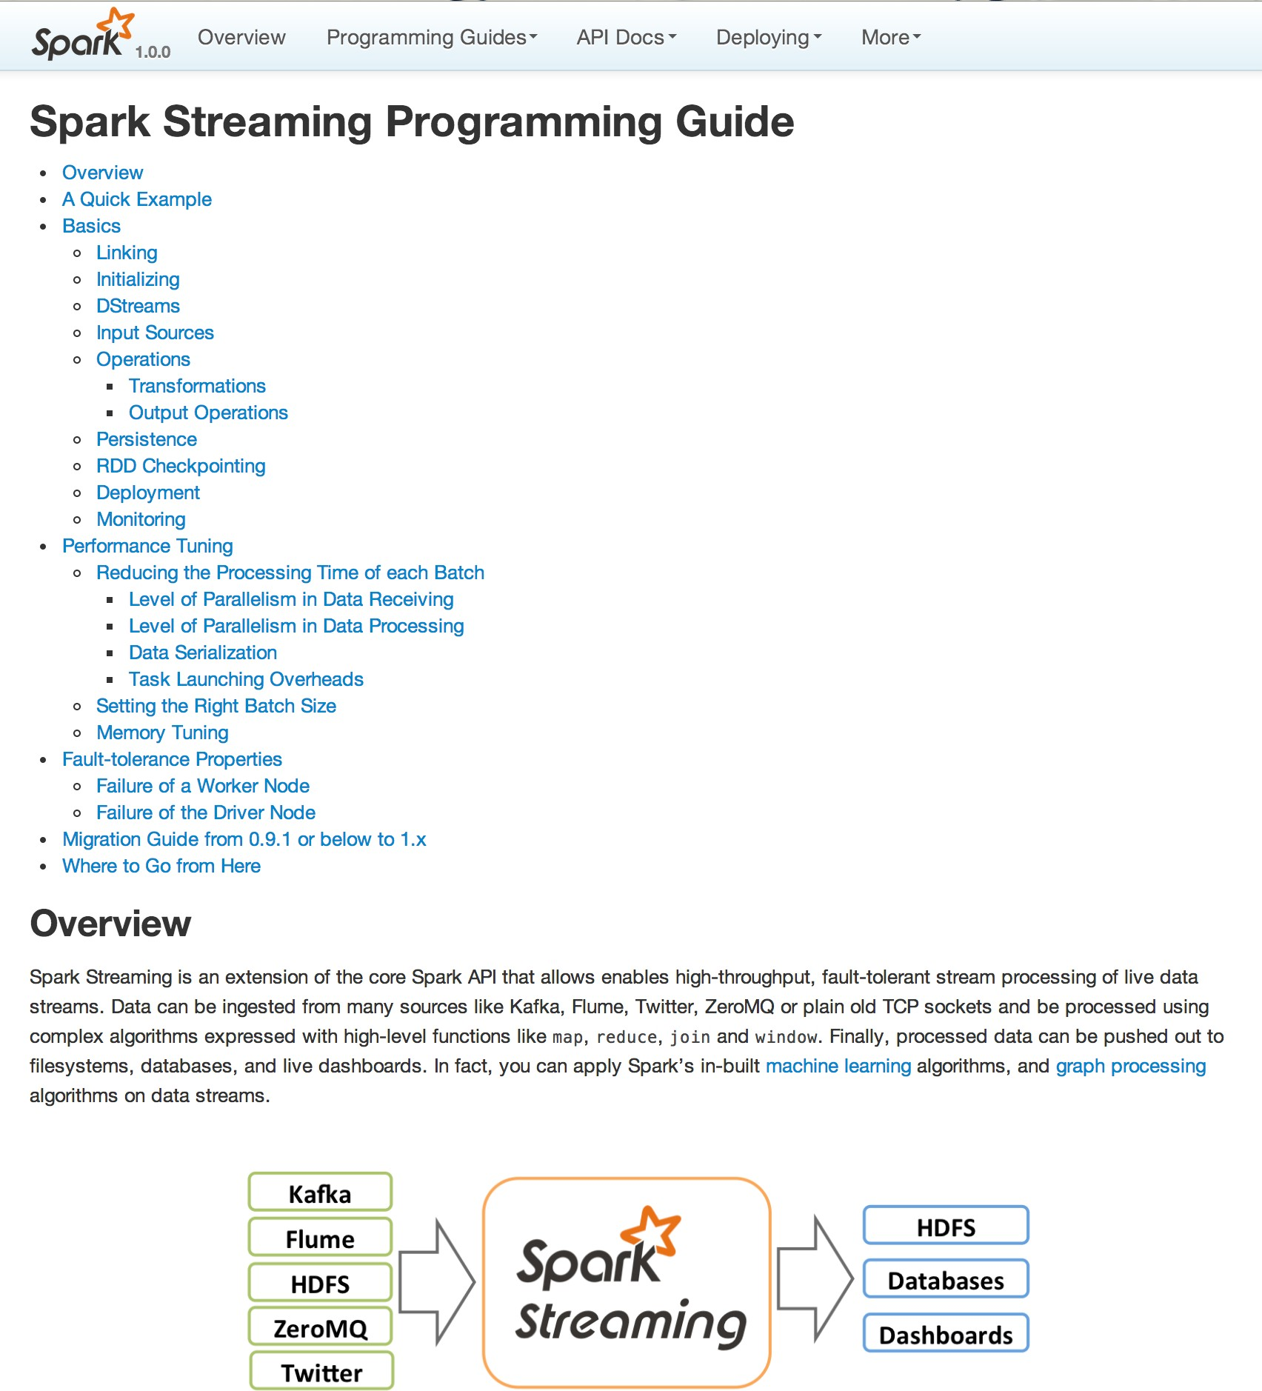
Conclusion
Notes:
https://slidetodoc.com/spark-streaming-largescale-nearrealtime-stream-processing-tathagata-das-4/

Slide 26
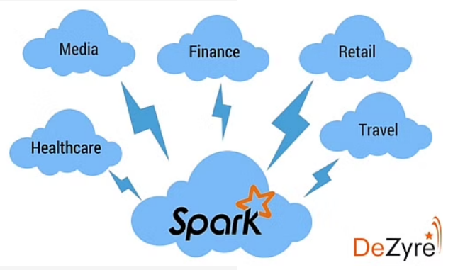
Why Apache Spark
The creators of Apache Spark polled a survey on “Why companies should use in-memory computing framework like Apache Spark?” and the results of the survey are overwhelming –
91% use Apache Spark because of its performance gains.
77% use Apache Spark as it is easy to use.
71% use Apache Spark due to the ease of deployment.
64% use Apache Spark to leverage advanced analytics
52% use Apache Spark for real-time streaming.

